Slide 1
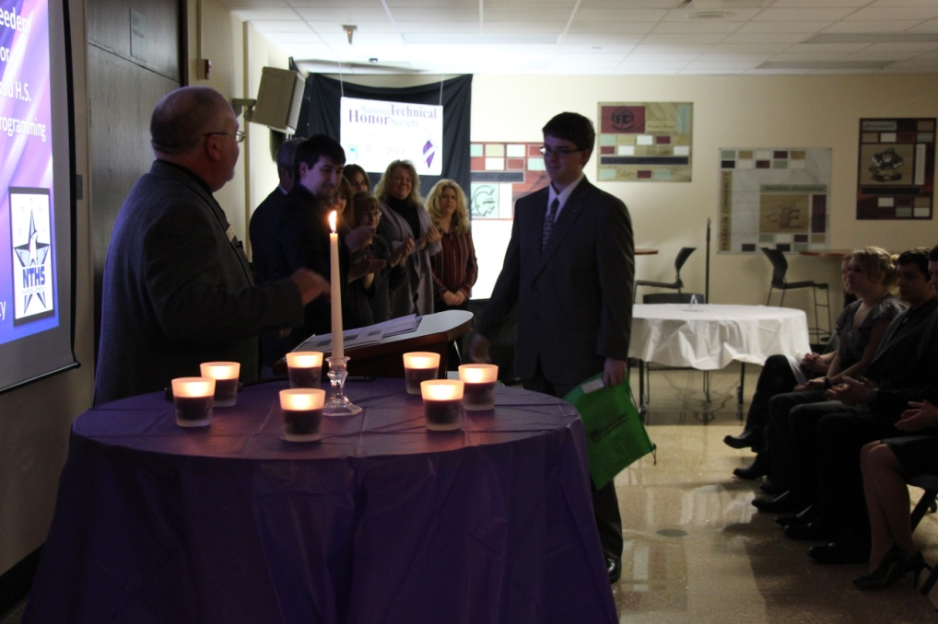
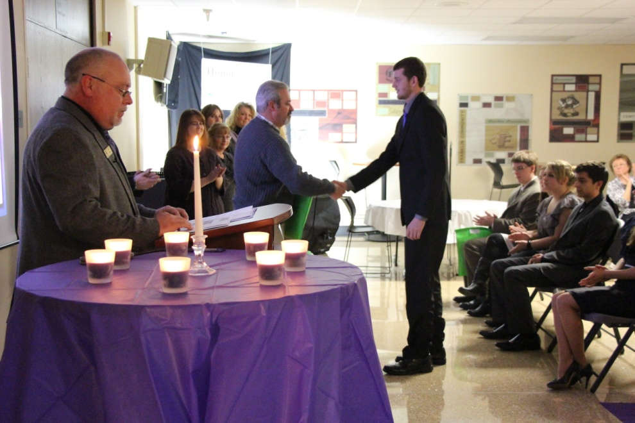
2013-2014
National Technical Honor Society
Induction Ceremony
January 15, 2014

Slide 2
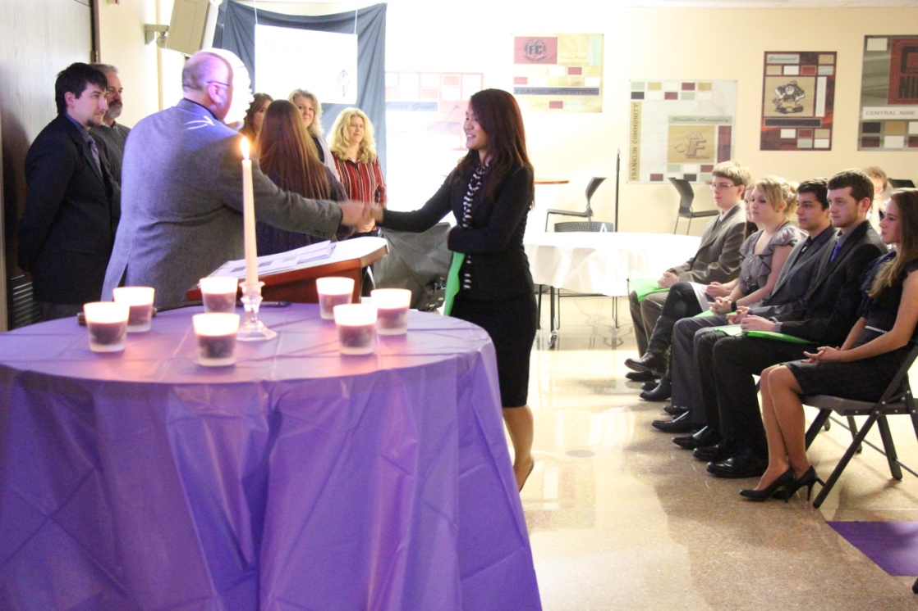
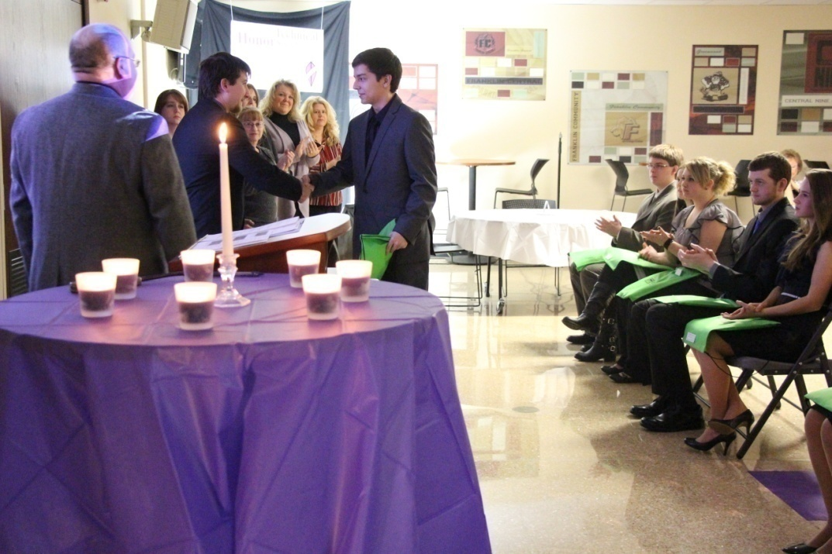
Students being
Inducted into
The N.T.H.S.

Slide 3
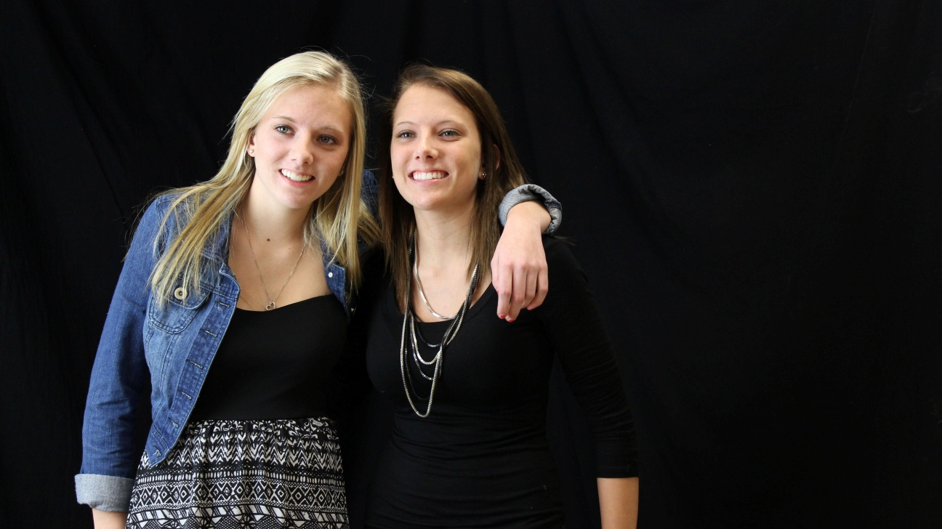
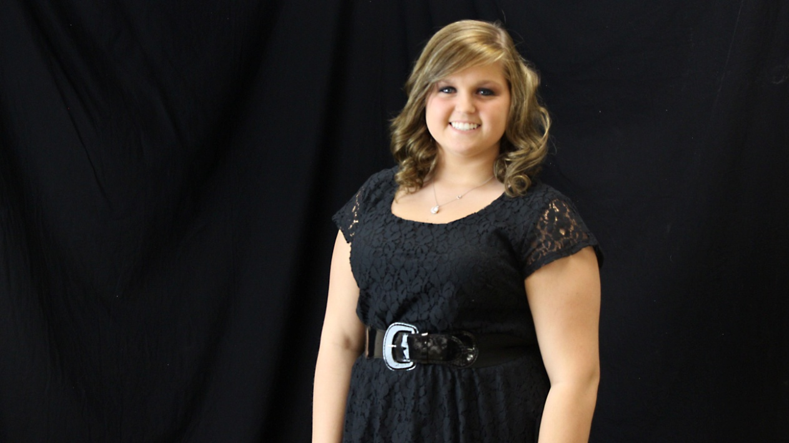
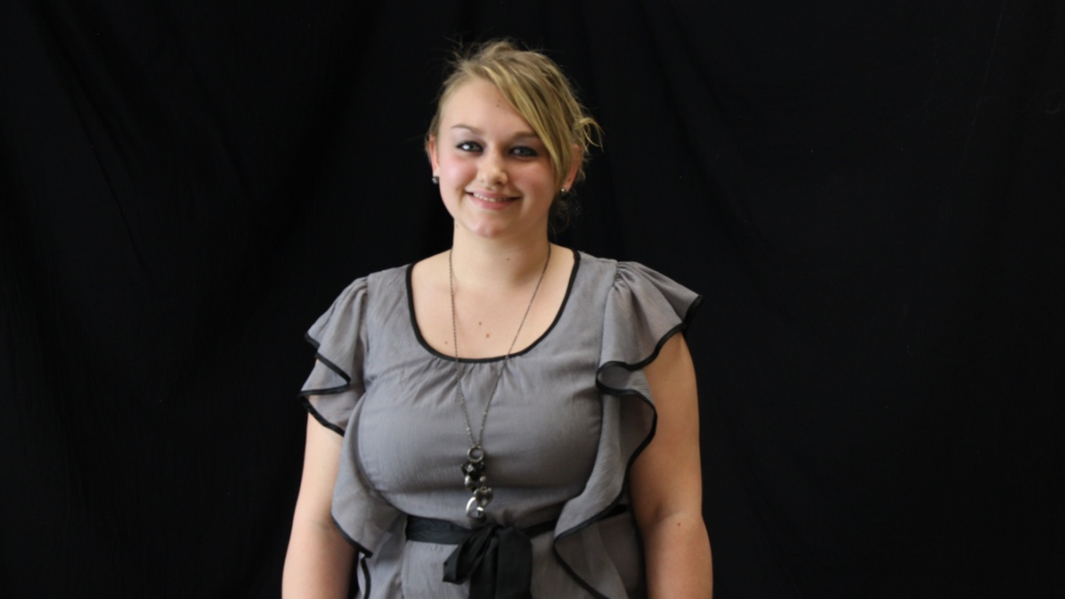
Allison and Jordan Weed
Center Grove H.S.
Jenna McHenry
Franklin Central H.S.
Hailee Hanaway
Whiteland H.S.

Slide 4
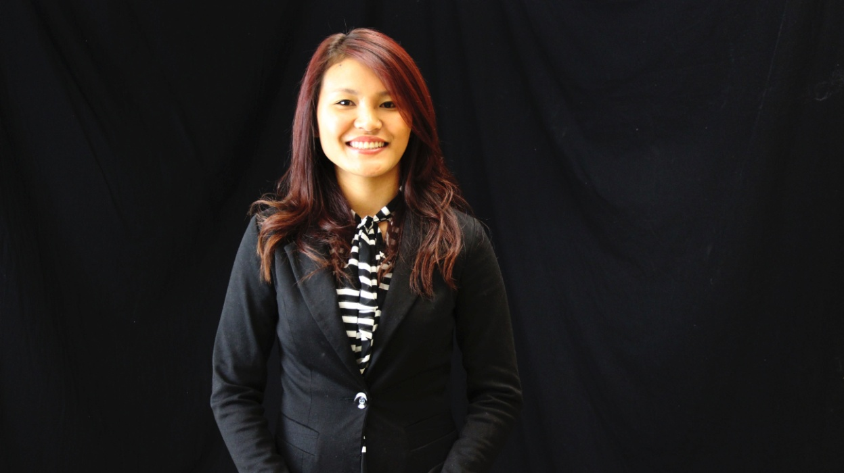
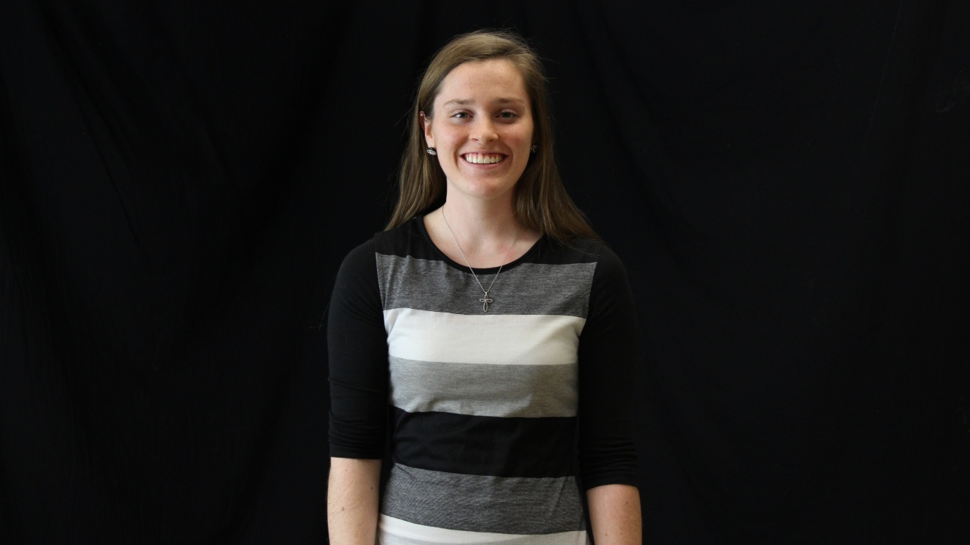
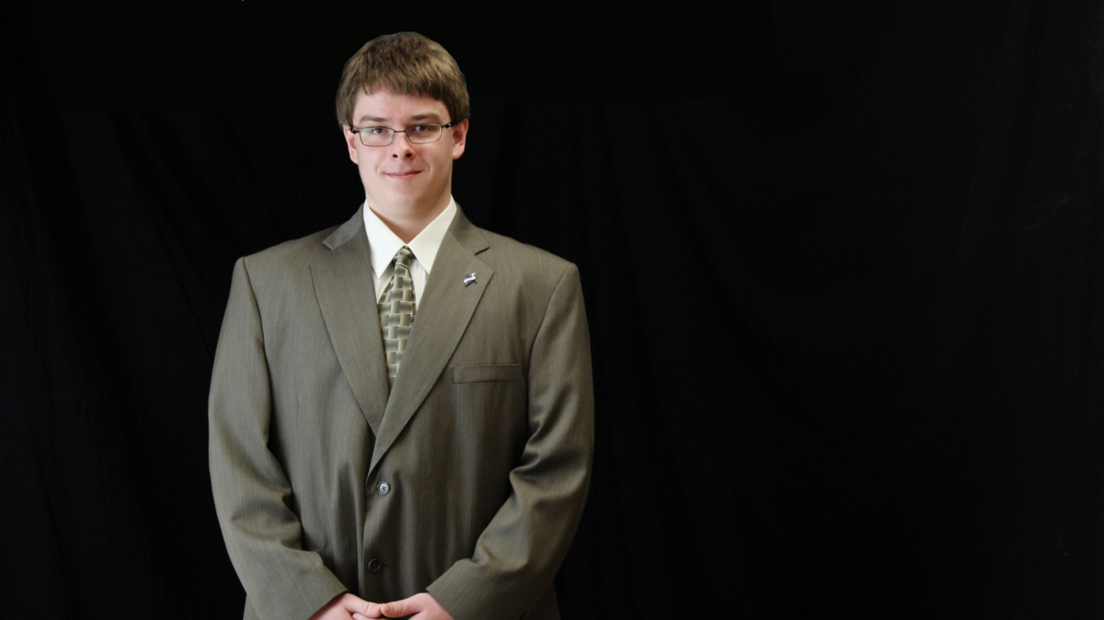
Sonia Meng
Southport H.S.
Rachel Sears
Franklin Central H.S.
Brian Breeden
Greenwood H.S.

Slide 5
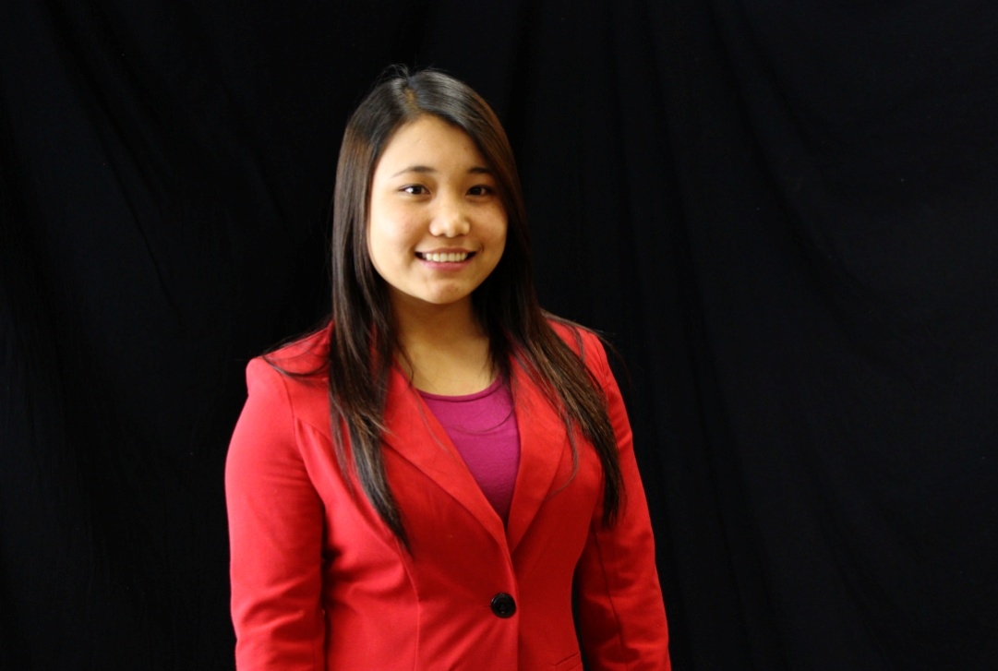
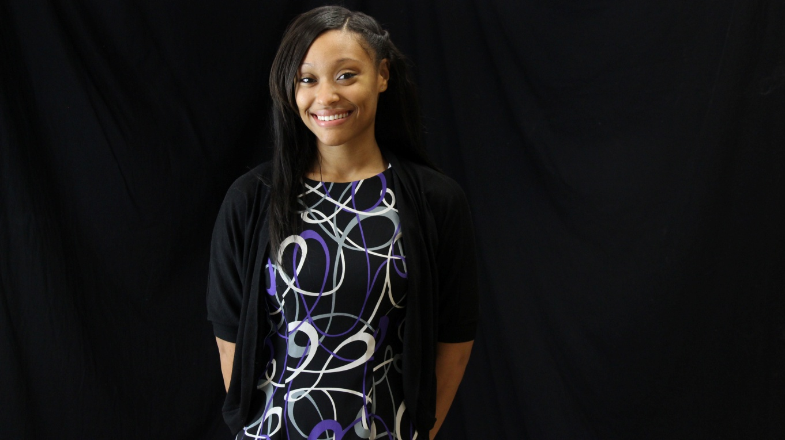
Biak Mawi
Southport H.S.
Eric Bullard
Southport H.S.
A.J. Haley
Perry Meridian H.S.

Slide 6
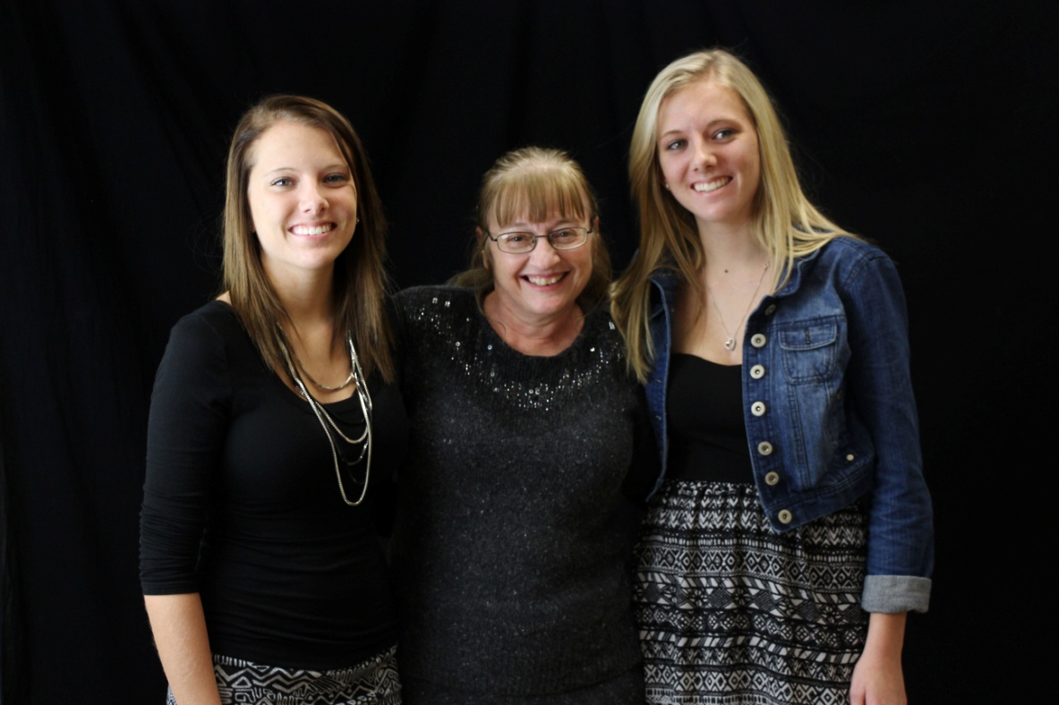
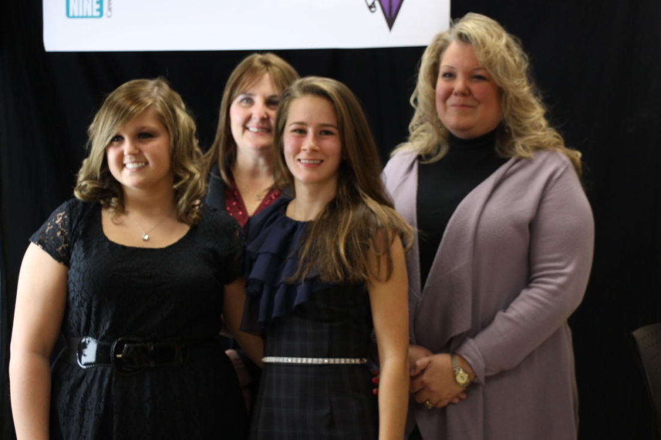
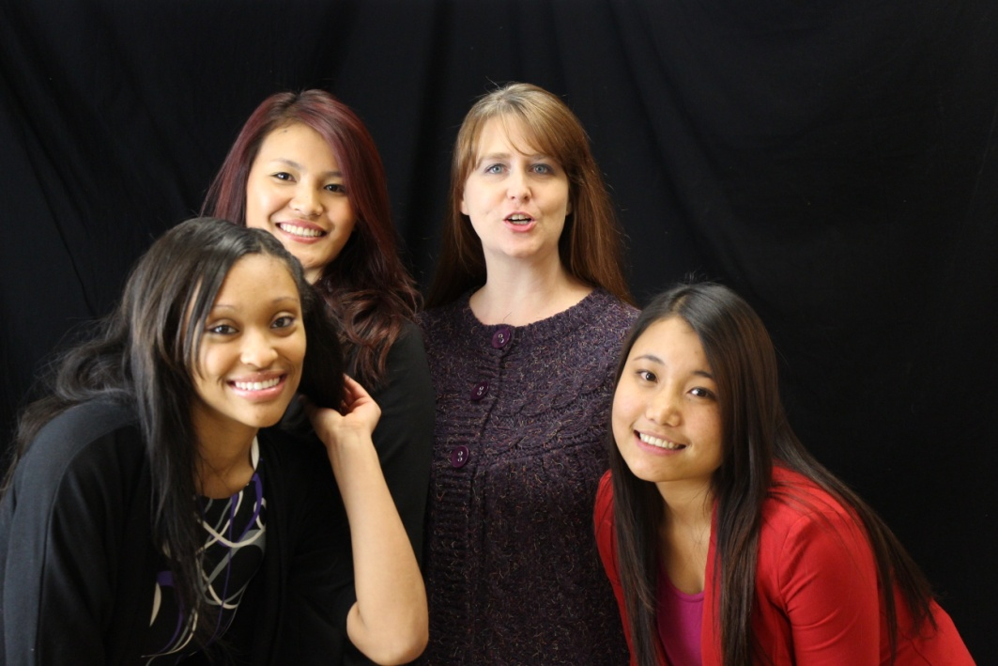
Mrs. Lawton with Allison Weed (Center Grove)
And Jordan Weed (Center Grove)
Mrs. Zimmer and Mrs. Milewski with
Jenna McHenry (Franklin Central) and
Kathryn Peterson (Triton Central)
Mrs. Irish with Sonia Meng (Southport),
Biak Mawi (Southport), and A.J. Haley (Perry Meridian)

Slide 7
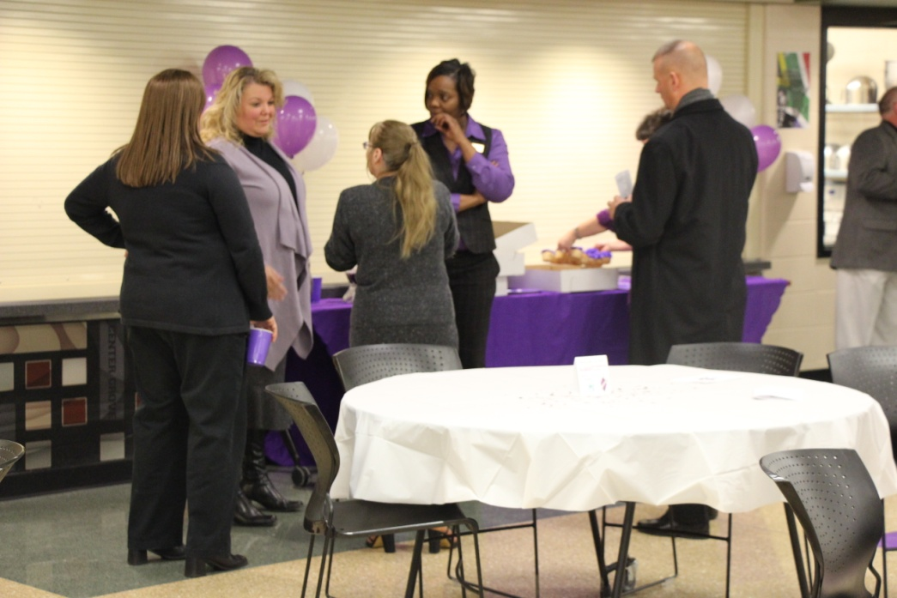
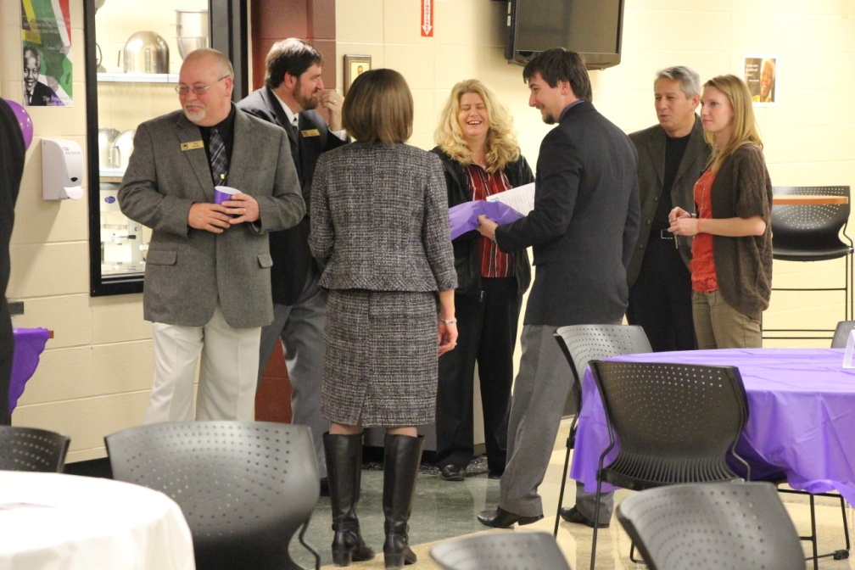
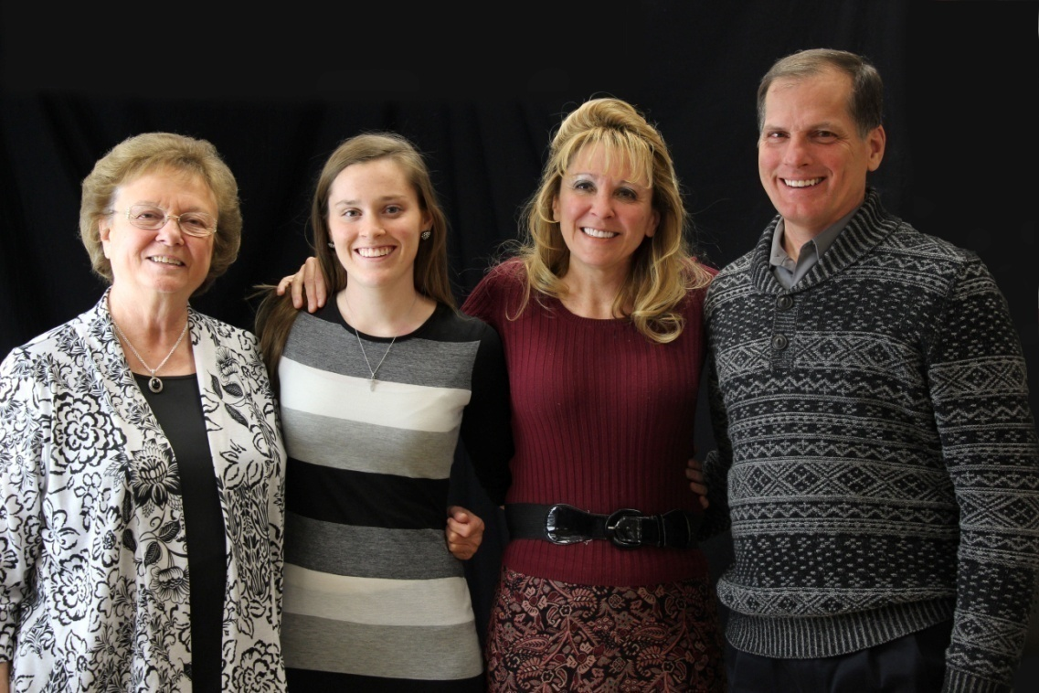
Central Nine staff supporting the new members
Rachel Sears (Franklin Central) with her family

