Slide 1
CENTRAL NINE CAREER CENTER QUESTIONS FOR CONSIDERATION FEBRUARY 10, 2014
Educational Services Company
3535 E. 96th Street, Suite 126
Indianapolis, IN 46240
317.818.3535
317.818.3533 FAX
Presented by:
Timothy Armstrong, Consultant

Slide 2
QUESTIONS TO BE ADDRESSED
How much is each district paying to Central Nine Career Center in each of the three funds (General, Capital Projects, and Transportation)?
How is the amount each district pays to the various funds calculated?
How much is each district generating in their General Funds as a result of students at Central Nine Career Center? How does this number compare with the amount paid?
How much would each district generate if they sent their total allocation of students?
How much of the total expenditures of each district (General Fund, Capital Projects, Transportation) is going to Central Nine Career Center to operate their programs?

Slide 3
HOW IS THE AMOUNT OF EACH DISTRICT’S BILLING DETERMINED?
STEP 1: Central Nine staff prepare a budget of anticipated expenditures for each fund (General, Capital Projects, Transportation).
STEP 2: The budgets are approved by the Governing Body of Central Nine Career Center.
STEP 3: The district’s receive their first billing on July 1. This billing is for 20% of each of the three budgets and is based on the assessed value of each district. For example, for the 2012-13 school year, Beech Grove Schools had 3.4341% of the total assessed value of all eight member districts. On July 1, 2012, they were billed for 3.4341% of the total billing.
NOTE: THE FIRST BILLING IS THE BASIC “MEMBERSHIP FEE” REQUIRED OF EACH MEMBER DISTRICT AND IS NOT IMPACTED BY ANTICIPATED OR ACTUAL ENROLLMENT. IF A DISTRICT SENDS NO STUDENTS, THEY WOULD STILL BE RESPONSIBLE FOR THIS PAYMENT PER THE ORIGINAL AREA SCHOOL AGREEMENT.

Slide 4
STEP 4: The second billing is on September 1 and is for 25% of the three budgets. This billing is based on the projected enrollment of Central Nine students for each district.
STEP 5: The third billing is on November 1 and is for 25% of the three budgets. This billing is based on the actual enrollment of Central Nine students for each district.
STEP 6: The final billing of each school year is on March 1 and is for the final 30% of the three budgets. This billing is also based on the actual enrollment of Central Nine students for each district.

Slide 5
HOW DO WE DETERMINE THE AMOUNT OF REVENUE EACH DISTRICT RECEIVES AS A RESULT OF THEIR CENTRAL NINE STUDENTS?
One-half of the regular state support per student (they spend ½ of their day at Central Nine). For all districts, this amount is $4,342 divided by 2 equals $2,171 per student.
PLUS the Additional Pupil Count revenue (APC). Each district receives state funding for each student sent to Central Nine Career Center. The per-student payment varies from $250 to $450 per student for Central Nine programs.
PLUS $150 per student for Area Participation. This is paid when students from two or more schools are in the same CTE course, a given at Central Nine Career Center.
We total these three amounts to arrive at the revenue generated by each district as a result of their participation at Central Nine Career Center.

Slide 8
WHAT PORTION OF THE TOTAL BUDGET OF EACH DISTRICT IS SPENT TO SUPPORT THE PROGRAMS OF CENTRAL NINE CAREER CENTER?

Slide 9
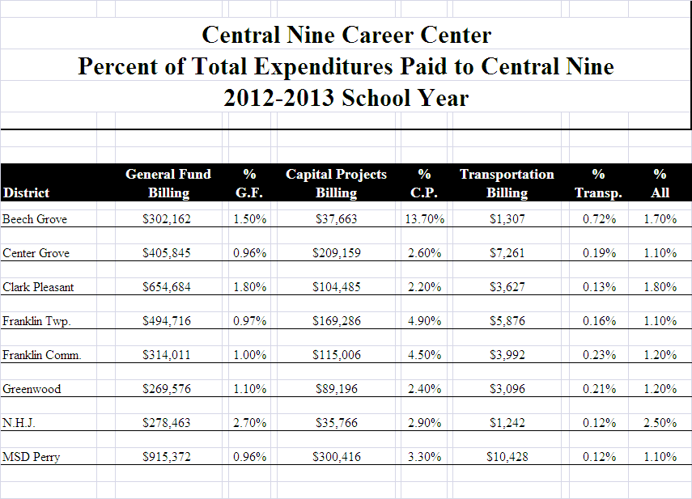

Slide 10
“Our business is hamburgers”
Ray Kroc
Founder, McDonald’s

Slide 11
QUESTIONS?

