Slide 1
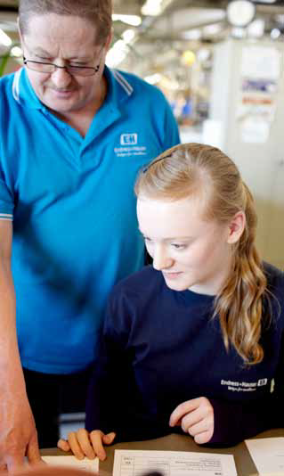
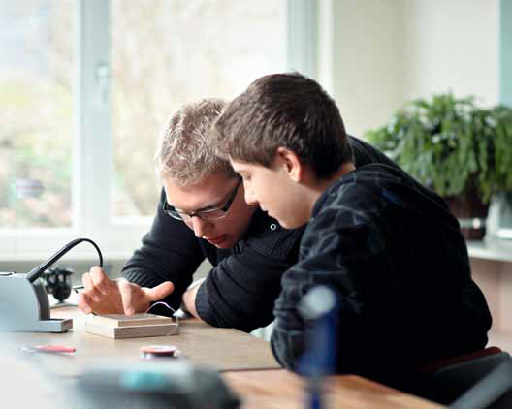
1st Annual Community Career+Education Forum for students

Slide 2
1st Annual Community Career+Education Forum for students
Hosted by Endress+Hauser
  Global leader in measurement instrumentation, services, and solutions for industrial process engineering.
In partnership with Central Nine Career Center
Connecting local students, parents, educators, and businesses together to raise awareness and provide information about the types of careers and opportunities that exist in Advanced Manufacturing.
    - Incoming middle school to high school seniors -
    - Career, education and information booths -
    - Endress+Hauser manufacturing booths –
    - Other local manufacturing booths –
    - Complimentary pizza dinner –
    - Live demonstrations –
    - Cool giveaways -

Slide 3
Aspire Johnson County – Central Nine – Endress+Hauser

Slide 4
1st Annual Community Career+Education Forum for students
Thursday, June 26, 2014
5:00 p.m. to 8:30 p.m.
Open event (parents and students come anytime)
7:00 p.m. Welcome and Greetings
Location: Endress+Hauser, 2355 Endress Place, Greenwood, 46143
Expecting ~ 200 parents/students

Slide 5
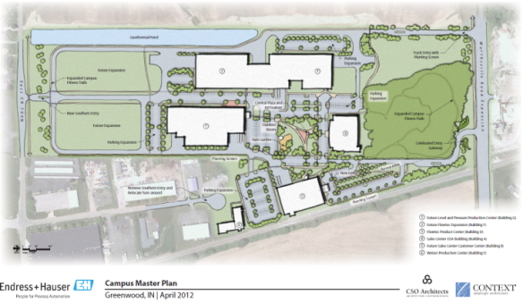
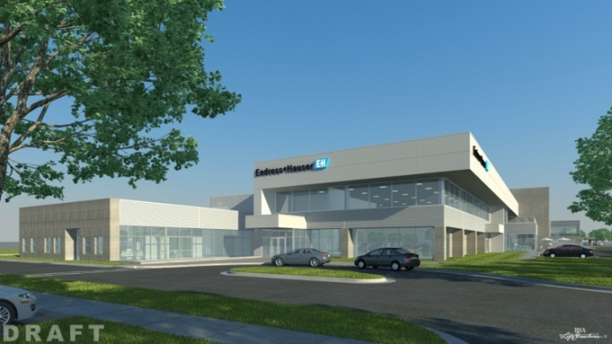
1st Annual Community Career+Education Forum for students

Slide 6
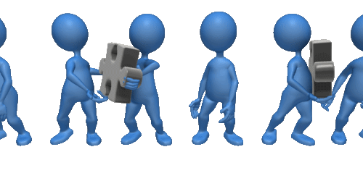
Collaboration takes effort…
Businesses ⬄ Schools ⬄ Parents ⬄ Students ⬄ Other stakeholders

Slide 7
E+H’s “Pipelines + Pathways” program scope
A long term approach of developing applicant pools to address our company’s needs, our customer’s needs, and our industry’s needs for talent. This includes raising awareness of the careers within Process Control / Automation industry and raising awareness locally of Endress+Hauser as a world class employer.
Target audiences in 2014:
  Parents and education professionals of incoming middle to high school seniors in C9 schools
  Incoming Middle through high school, and college students
  Faculty and staff within targeted technical colleges and universities
  MCAA and other industry specific associations
  Local, State, and Federal elected officials
  Local Chamber of Commerce and Economic Development organizations

Slide 8
Pipelines + Pathways (the “components”)
Annual Community Career+Education Forum
Tours for teachers/professors/parents/students
Job Shadowing
Internships/Co-ops
Opportunities for teachers to teach at E+H (e.g. Process Training Unit)
Use of E+H online learning modules being used in the classroom at schools/universities
Opportunities for our E+H experts to teach students; teach-coach teachers and Guidance counselors
Help develop advanced manufacturing/process control/automation curriculum at the university level
The hope is that other manufacturing companies will share this vision!
  E.g. Hosting the Career Forum in future years.

Slide 9
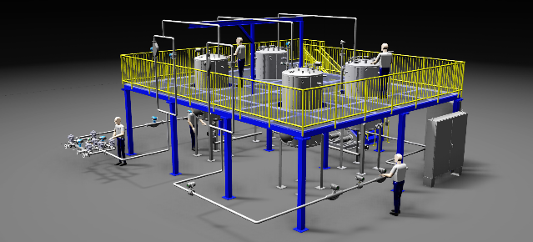
Process Training Unit to demonstrate products

Slide 10
Participants (Schools and Advanced Manufacturers)
Endress+ Hauser | Central Nine | Franklin Community | Caterpillar | Greenwood | Clark-Pleasant
Beech Grove? | Center Grove? | Franklin Central? | Indian Creek? | Perry Meridian? | Southport?
Nachi? | KYB? | NSK? | Purdue? | Ivy Tech | ?
? | ? | ? | ? | ? | ?
? | ? | ? | ? | ? | ?
? | ? | ? | ? | ? | ?

Slide 11
Next Steps
Does your school wish to participate?
Who are the contacts that we need to get with?
Who are the STEM go-to people?
We need approval to use your logo(s) – and the actual high resolution logo(s)
We need each participating school/business to complete an Event Exhibitor Information form
Idea: Each school to target x amount of students to be at the Forum (based on school size)
At a goal of 200 parents/students, that = 120 parents and 80 students (based on 1.5 parents per student)
What does it take to get to 200? If each of the 9 school corporations commit to targeting 24 students, ~15 will say yes, and 9 will show up. That is how we reach 200.

Slide 12

June 26th is the finish line (and just the beginning)!

Slide 13

Questions?

Slide 14
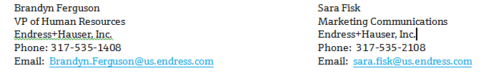
Contact info

