Slide 1
CTE Innovation Grants

Slide 2
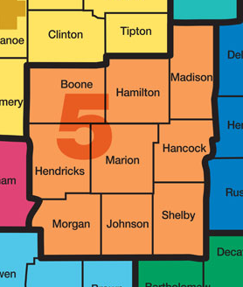
Background
Works Councils & CECI
4.365 Million in Funding
Matching Grants to Private Investment

Slide 3
Dates
04/15/14
DUE to Region #5 Works Council
Feedback
Opportunity to make Changes/Improvements
05/15/14
Final applications due from Region #5 to CECI
January 2015
Phase 2 – Possible HVAC Program Application

Slide 4
Feedback
Statement of Need/Proposed Partnerships
Description of Proposed Innovative Curriculum
Performance Measures/Sustainability
Budget

