Slide 1
Riley Simpson Culinary Arts, Level One

Slide 2
2014 – 2015 Accomplishments:
Member, Competitor: SkillsUSA, Culinary Arts
C9 Tour Talker, Student Ambassador
Student Representative, Webb Elementary Career Day
Volunteered Services for all After-School Culinary Catering Functions
Successful Completion, National Restaurant Association, Foundations of Restaurant Management and Culinary Arts, Level One Certification (May, 2015)
“Solo,” In-School Catering Events (Dr. Edds, Mr. Courtney)

Slide 3
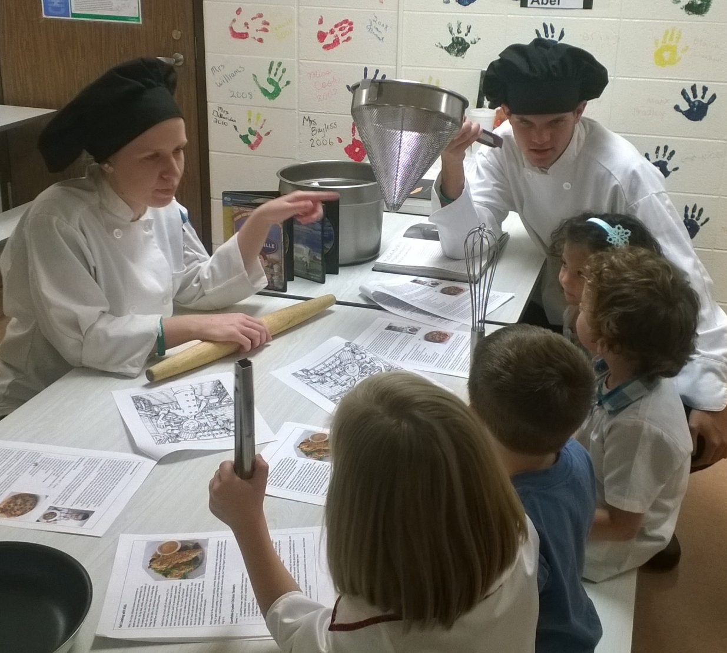
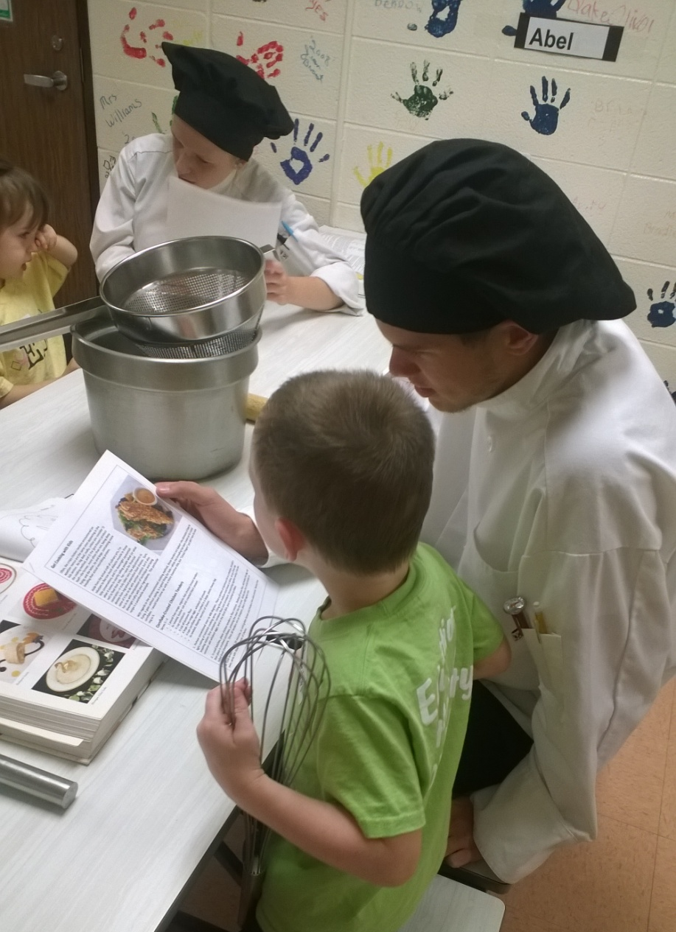
Webb Elementary Career Day

Slide 4
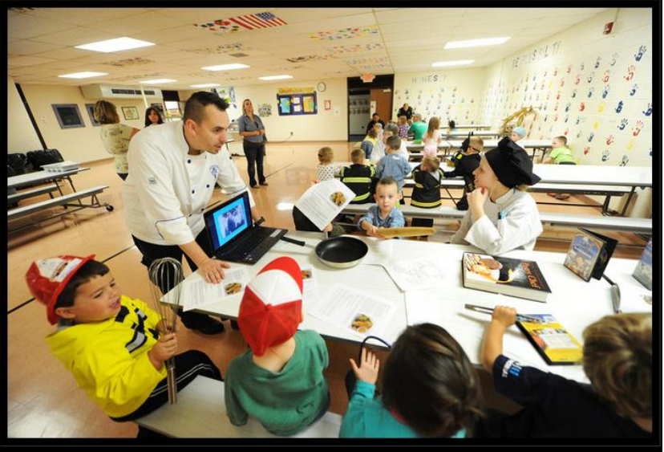
Webb Elementary Career Day

Slide 5
Webb Elementary Career Day

Slide 6
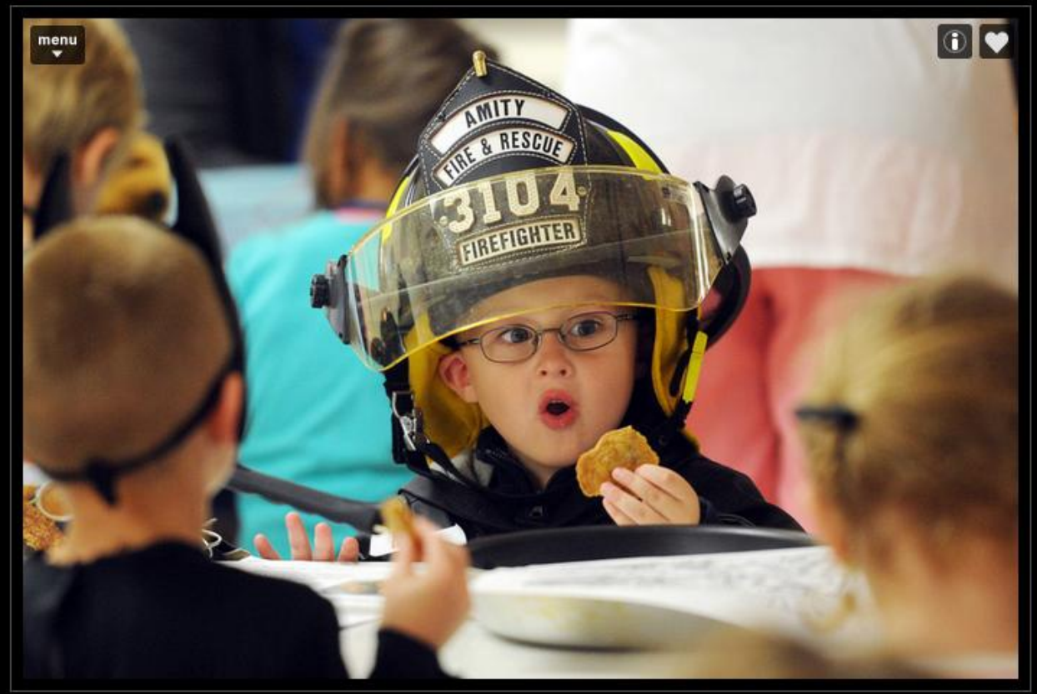
Webb Elementary Career Day

Slide 7
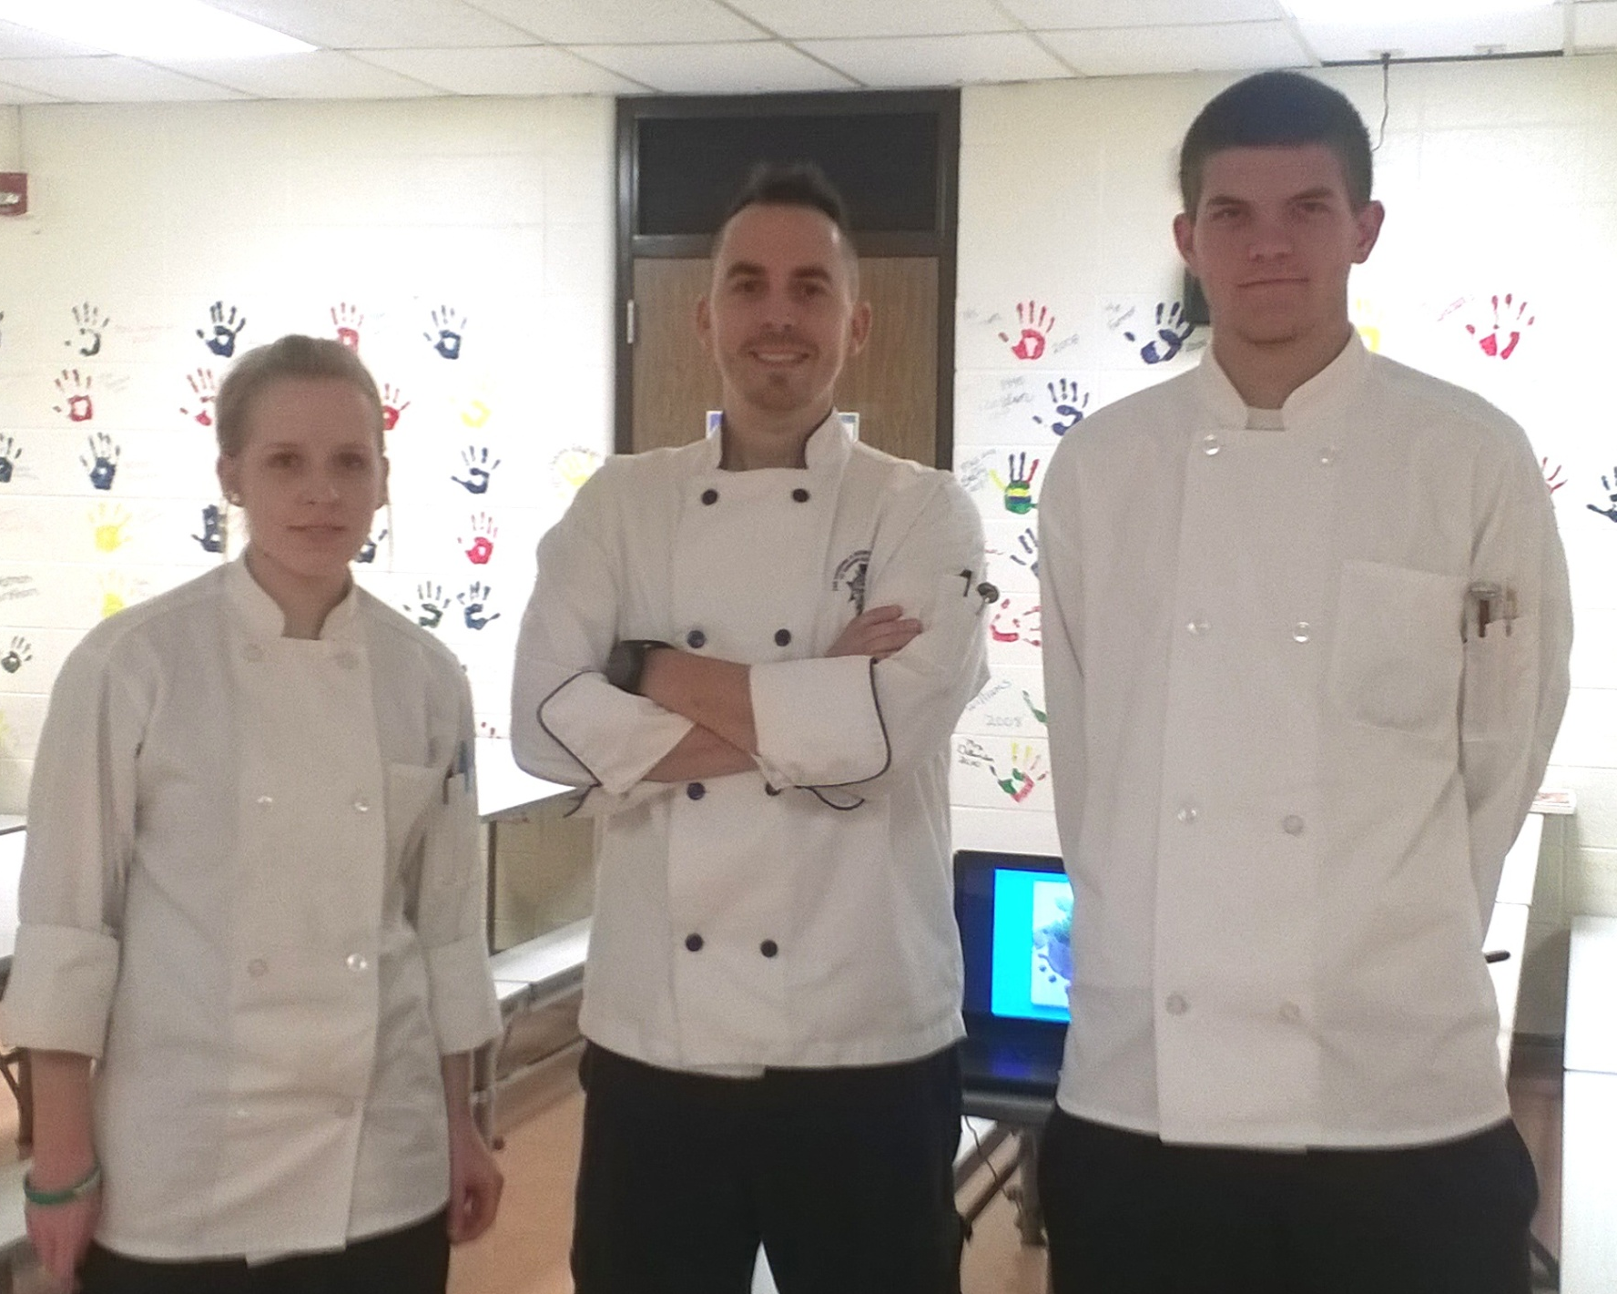
Webb Elementary Career Day

Slide 8
Franklin Central C9 Promo: Franklin Township Informer: April, 2015
Riley Simpson

Slide 9
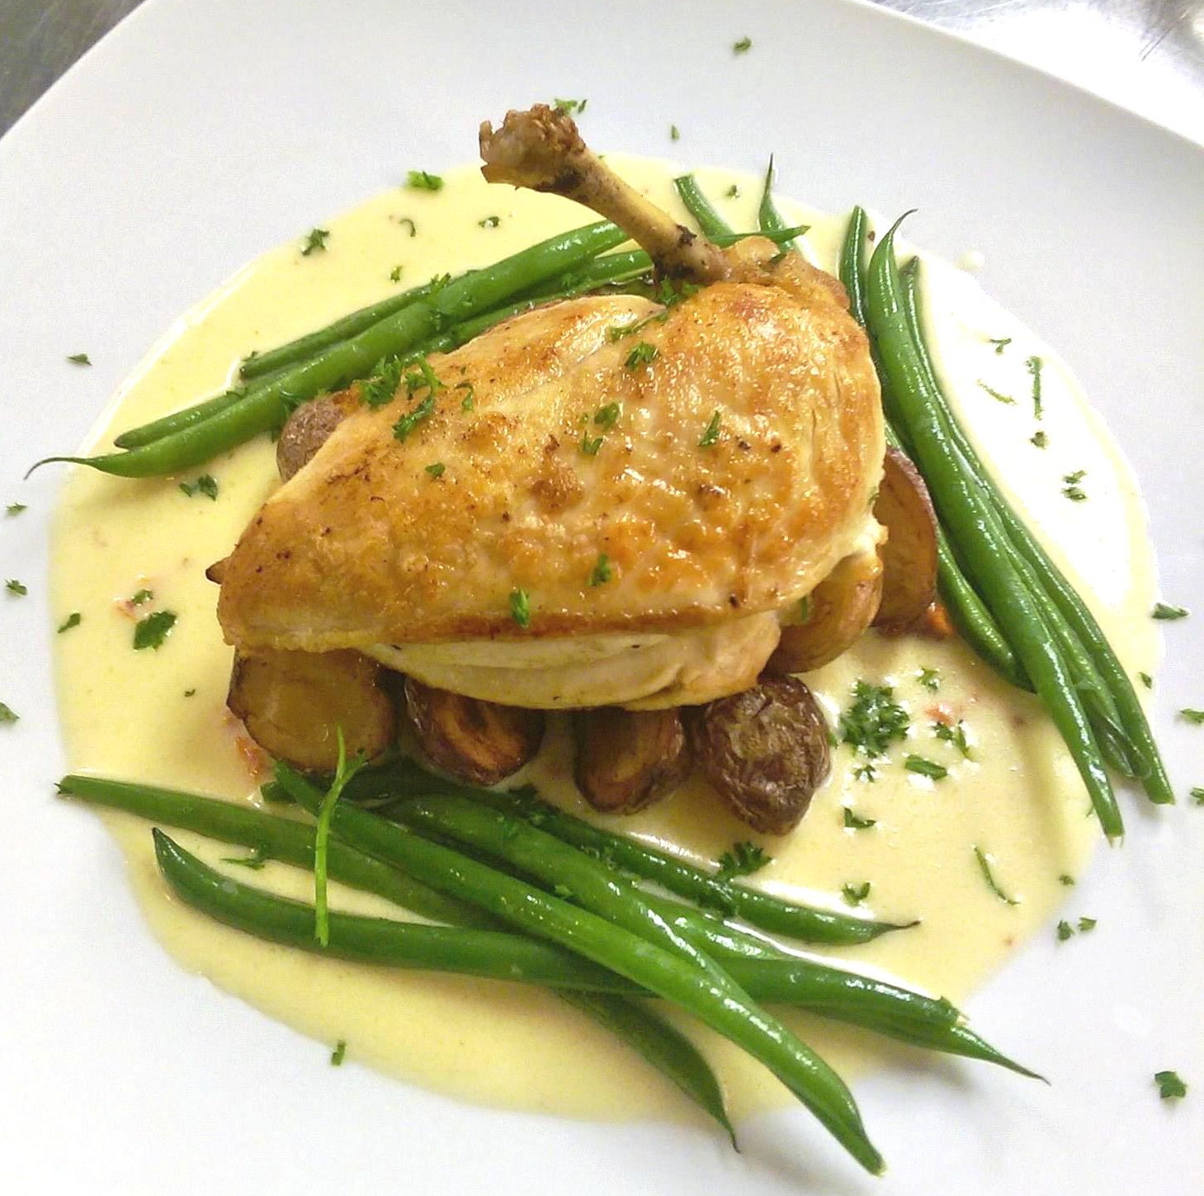
“Solo” Student-Catering Projects Dr. Edds and Mrs. Otte: February, 2015
Pan-Seared, “Airline” Chicken Breast Served with White Wine Beurre Blanc, Served with Bacon-Roasted Potatoes and Steamed Haricot Verts

Slide 10
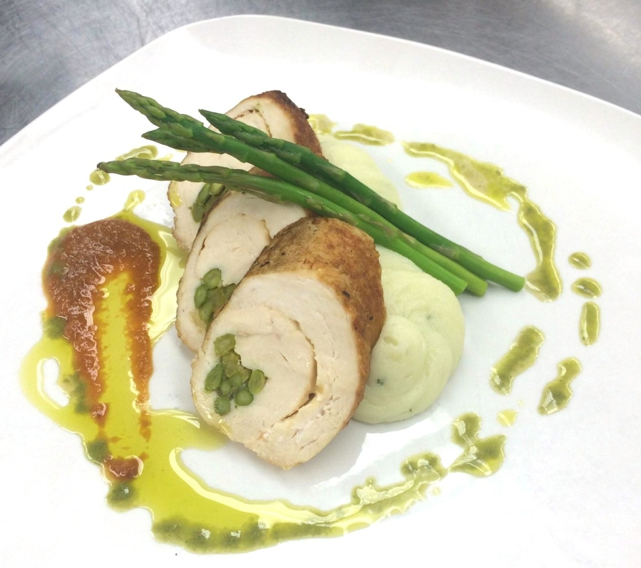
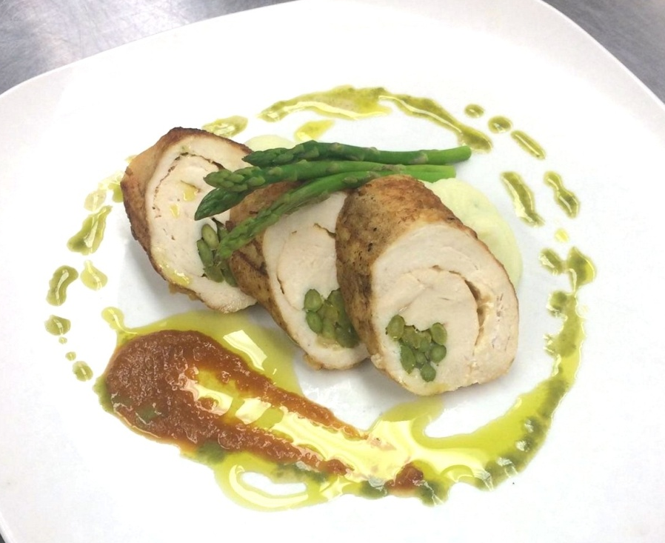
“Solo” Student-Catering Projects Mr. Courtney, Principals Lunch: May, 2015
Oven-Roasted Chicken Breast Stuffed with Asparagus and Smoked Gouda, Roasted Tomato Sauce, Basil Oil, Accompanied by Herb-Whipped Potatoes and Poached Asparagus

Slide 11
National Restaurant Association: Level One Certification in Foundations of Restaurant Management and Culinary Arts

