Slide 1
Precision Machine Technology
From WWII machinery to the newest high tech manufacturing machine tools

Slide 2
C-9 Machine Trades 1990’s
All manual machines
Most came from the, “Tools for Schools Program” in the early 70’s
These were machines that were on Navy ships during World War II
Hand cranks
No digital readouts
Poor Condition

Slide 3
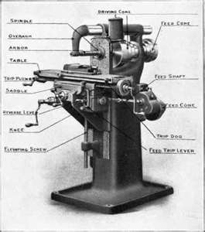
What we started with
Manual Mill

Slide 4
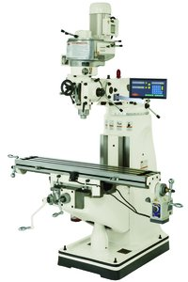
A few years later
We added digital readouts
We added power feeds
Upgrading old machines

Slide 5
C-9 Precision Machine Technology 2008 and Beyond
CNC- Conversational Programming Mills
Color Graphics
Power Drawbars
Three Axis Interpolations
X-Y-Z Axis Driven by Servo-Motors
Servo-Motors controlled by Computer Numerical Control

Slide 6
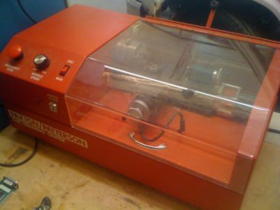
Computer Controlled Lathe
FANUC-G&M Programming
Two Axis Interpolations
Full Editing Capabilities

Slide 7
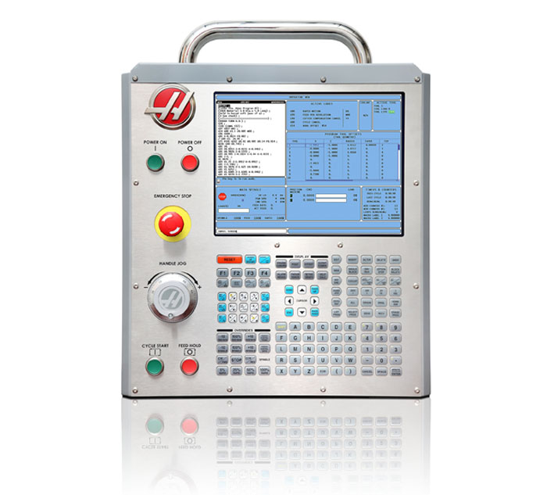
HAAS Simulator

Slide 8
HAAS Simulator
Both Lathe and Mill Programming Software
Tool Path Graphics
Industry Standard G&M Code Programming
Program Tool Path on Simulator /Using Flash Drive Download Program to Haas Mill to Make the Part
Store Multiple Programs
Full Editing Capabilities

Slide 9
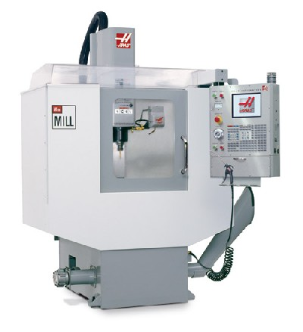
HAAS MILL

Slide 10
HAAS MILL
Stores multiple programs
Complete editing of programs
Will accept several programming formats (IGES Files)
Three axis interpolation
Multiple workoffsets
Automatic tool changer
Through spindle coolant
Spindle and feedrate override

Slide 11
Just a few of the manufacturing facilities where PMT students are employed
Major Tool & Machine
Precision Products
Apex Technologies
IMC Corp.
Schumacher Machine
Sarah Fisher Racing
Panther Racing
NSK Corp.
Delaware Dynamics

Slide 12
Continued
Diverse Fabrication
Garrity Tool
Baker Machine
Overton Industries
Eli Lilly
Morris Machine
Power Dyne
Many more
There are over 200 Machine Shops listed in the Central Indiana Business to Business Yellow Pages

